Slide 1
Virtualization
Dr. Prashant B Jawade
Dept of CSE
Government College of Engineering, Nagpur

Slide 2
Virtualization
Virtualization is a process that allows for more efficient utilization of physical computer hardware and is the foundation of cloud computing.
Virtualization is a methodology for dividing the computer resources to more than one execution environment by applying more concepts like partitioning, time-sharing, machine simulation and emulation.
Virtualization uses software to create an abstraction layer over computer hardware that allows the hardware elements of a single computer—processors, memory, storage and more—to be divided into multiple virtual computers, commonly called virtual machines (VMs
Virtualization can be expressed as a brand new trend in IT, which includes autonomic computing and utility computing.
This new trend helps the IT environment to manage itself and every available resource is seen as a utility, where a client pays per use.
Virtualization reduces the burden of workloads of users by centralizing the administrative tasks and improving the scalability and workloads.

Slide 3
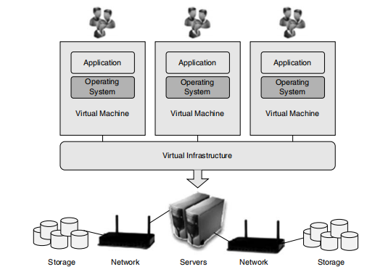
A single virtual infrastructure can support more than one virtual machine, that is, more than one OS and application can be deployed.
Physical resources of multiple machines of entire Infrastructure are shared in virtual environment.
Resources of a single computer are shared across many virtual machines for maximum efficiency.
A virtual infrastructure consists of the following components: hypervisors, virtual infrastructure services and automated solutions to optimize IT process.
Fig. Virtulization

Slide 4
Following are some reasons for using virtualization:
Virtual machines (VM) consolidate the workloads of under-utilized servers. Because of this
One can save on hardware, environmental costs and management.
To run legacy applications, VM is used.
VM provides a secured and sandbox for running an untrusted application.
VM helps in building secured computing platform.
VM provides an illusion of hardware.
VM simulates networks of independent computers.
VM supports to run distinct OS with different versions.
VMs are uses for performance monitoring.
Operating systems can be checked without disturbing the productivity.

Slide 5
VM provides fault and error containment.
VM tools are good for research and academic experiments.
VM can encapsulate the entire state of a system by saving, examining, modifying and reloading.
VM enables to share memory in multiprocessor architecture.
VM makes the job easier for the administrative staff in migration, backup and recovery.

Slide 6
ADOPTING VIRTUALIZATION
Virtualization is a perfect solution for small to medium-scale enterprises.
It does not suit high performance applications and should be avoided. It may be possible to add overheads, complexity and reduce the performance.
In virtualization, the IT industry has a high CPU utilization number
indicating optimum usage of hardware; and based on this number
one should not come to the conclusion about the application usage.
By using virtualization, CPU utilization during peak hours will shoot up to 50% and it should not override the SLA (service level agreement) of an organization.
At present, in virtualization, the CPU and I/O overhead for storage and networking throughput are minimal, when high storage or more hardware I/O requirements are needed, then avoid using VM.

Slide 7
TYPES OF VIRTUALIZATION
Virtualization is a very powerful tool that drives significant benefits for cost, agility and the environment.
Today virtualization is applied in many places—server virtualization, client/desktop/application virtualization, storage virtualization and service/application infrastructure virtualization.
An end-to-end virtualization strategy impacts all features of the IT infrastructure.
This gives the consumer flexibility, greater efficiencies and cost-effectiveness.

Slide 8
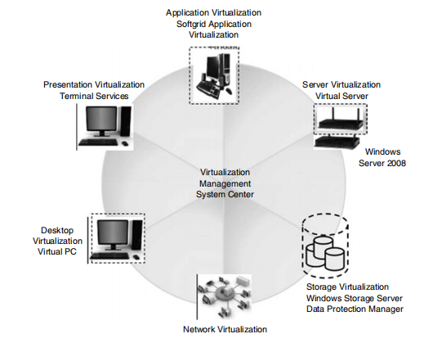
Fig. Types of Virtualization

Slide 9
Network Virtualization:
is a method where network resources are combine based on available bandwidth.
Each channel is assigned to a particular server.
With this method of virtualization, a true complexity of network is hidden and managed like partitioning the hard drive.
Because of network virtualization, lower TCO,higher return of investment, security and dynamic computing are obtained.
Storage virtualization:
is a type of virtualization, where a pool of physical storage from different network of storage devices appears as a single storage device.
Usually this kind of virtualization is adopted in SAN (storage area networks).
Storage virtualization is advantageous in disaster recovery, business continuity, lower TCO, higher return of investment, dynamic computing, security, testing and development.

Slide 10
Server Virtualization
is a kind of virtualization, used for masking of server resources, which includes number of physical servers, processors and operating systems.
The intention of using this method is to spare the complicated server resources and hence increasing the sharing, utilization and maintaining the capacity of servers.
The newest major technology trend in the data centre is server virtualization.
It will be the highest-impact trend in IT infrastructure and operations
It has both positive and enormous impacts on corporate power, cooling expenses and data centre capacity.
It helps to extend the life time of data centres and even forced some huge organizations to close some of their data centres.
With server virtualization, a physical server can be partitioned into multiple virtual servers.
Each virtual server has its own operating system and applications and
acts as an individual server.
Because of this technology, one can complete his development using more
operating systems on one server, supporting multiple business forms.

Slide 11
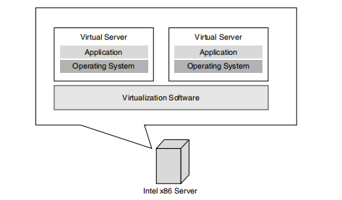
Server virtualization stacks multiple virtual workloads such as servers, applications that run on a single physical host.
Server virtualization softwares such as Hyper-V or VMware encapsulates an operating system and its applications to run in isolated processors and memory spaces of the host.
Fig. Server Virtualization
Fig. Server virtualization

Slide 12
Server virtualization masks the server resource which includes the servers, processors and operating systems from the server users.
Server administrator isolates the application into many
virtual environments.
The virtual environments are called as guests, instances, containers or emulations.
It allows multiple applications to run on one server with equal importance.
Moreover, it permits one application to utilize resources across the company network.
Virtualization can allow applications to dynamically move from one physical server to another when the demands and
resource availabilities vary, without service disturbance.

Slide 13
Need for Server Virtualization
The need for server virtualization is consolidation, redundancy, legacy systems and migration.
Server virtualization reduces space through consolidation.
For IT organizations that have large number of servers, the need for single physical space can decrease the workload.
Server virtualization supports redundancy without purchasing more hardware.
Legacy systems using server virtualization the outdated systems services can be virtualized, hence the programs work as if it is executed in old systems.
Migration is a new trend in server virtualization. Migration moves a server environment from one place to another.
With the help of suitable hardware and software, it is possible to
migrate a virtual server from one physical machine to another in a network.

Slide 14
Three Kinds of Server Virtualization
There are three ways to create virtual servers—full virtualization, paravirtualization and OS-level virtualization.
Host is the physical server. Guests are the virtual servers.
The virtual servers are like stand-alone machines.
Complete virtualization utilizes software called hypervisor.
The connection point between server’s CPU and its storage space is hypervisor.
It serves as a platform for the virtual server’s OS.
Virtual servers operate independently and are not aware of other virtual servers using hypervisor.

Slide 15
The physical server’s resources are monitored by the hypervisor.
When any application runs on the virtual servers, the hypervisor passes resources from the physical machine to the proper virtual server.
Hypervisors have their own processing requirements and physical server reserves processing power and resources to be executed by the hypervisor application.
This will impact the overall server performance and slow down applications.
The paravirtualization approach is somewhat different. The virtual servers in a para virtualization system are aware of each other not like in the full virtualization technique.
A paravirtualization hypervisor uses less processing power to manage virtual OS.

Slide 16
Adopting a type of server virtualization is decided based on the requirements of network administrator.
If the administrator’s personal servers function on the identical functioning scheme, then an functioning scheme will work excellently.
If the administrator wants to install different OS, then para-virtualization is the best option.
Many industries support full virtualization, but interest in paravirtualization is also growing; soon it may replace full virtualization.
Visualizing a single physical server as multiple logical servers is called server virtualization.

Slide 17
Uses of server virtualization are summarized as follows:
Cost reduction in infrastructure such as hardware and its
maintenance.
Utilization of resource to the fullest
Increased efficiency of server
Increased security
Space saving in data centres

Slide 18
Limitations of Server Virtualization:
The benefits of server virtualization are more than its limitations.
It is important for a network administrator to learn server virtualization concepts before implementing it in his premises.
Virtualization is not a good choice for servers with applications demanding high on processing power, as it divides the processing power among the virtual servers.
Too many virtual servers will reduce the server’s ability in storing the data.
Another limitation is migration. Many organizations are investing in server virtualization in spite of its limitations. As server virtualization technology move forward, the need for massive data centres could decline.
As a green initiative, investing in server virtualization results in power utilization and heat reduction.

Slide 19
Virtual servers could lead to a complete revolution in the computing industry and this will give a wide opening to researchers to develop high end tools and to use it in Server Virtualization.

Slide 20
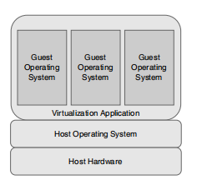
OS Virtualization:
OS virtualization somewhat differs from server virtualization.
Here, the host runs a single OS kernel and exports different operating system functionalities to every visitors.
In this model, common binaries and libraries are shared on the same physical machine, which permits an OS level virtual server to serve huge number of visitors.
OS virtualization is probably the easiest model to understand
This method has the greatest advantage that no modifications are required to either host or guest operating system and no particular CPU hardware virtualization support is required.
Fig. OS Virtualization

Slide 21
Kernel level virtualization:
In kernel level virtualization, the host operating system operates on a specially customized kernel, which includes extensions designed to manage and control several virtual machines each have a guest
operating system. Unlike shared kernel virtualization each visitor operates their own kernel, even though similar limitations apply, in that the visitor operating systems must have been compiled
for the same hardware as the kernel in which they are running. User Mode Linux (UML) and Kernel-based Virtual Machine (KVM) are examples of kernel level virtualization technology.
Hardware virtualization leverages virtualization characteristic construct into the most recent generations of Intel and AMD CPU.

Slide 22
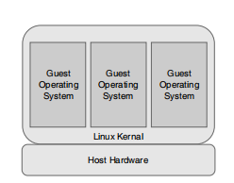
Fig. Kernel Level Virtualization

Slide 23
Under hypervisor level virtualization the host operating system contains an administrative environment to manage and control multiple virtual machines each containing a guest operating system.
An administrative operating system and/or management console also runs on top of the hypervisor in addition to the virtual machines which allows the virtual machines to be administered by a system administrator.
Hypervisor-based virtualization solutions include Xen, VMware ESX Server and Microsoft’s Hyper-V technology.
To achieve the best performance, management and efficiency of OS virtualization is streamlined.
A standard host operating system resides at the bottom that includes Windows and Linux.
Virtualization layer with the help of file system and abstraction layer guarantees resource.

Slide 24
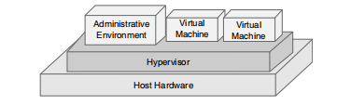
Fig. Hypervisor Virtualization

Slide 25
OS virtualizaiton, nothing exists. All tasks runs from the network using a virtual disk.
In the present implementations, this virtual disk is just an image file stored on a distant server, SAN or NAS.
The client will be connected to this virtual disk through the network and it will boot with the operating system available in the virtual disk.
The two types of virtual disks in most implementations are private virtual disk and shared/common virtual disk.
1. Private virtual disk: A private virtual disk acts as a key for a client, he can use it to store information, based on the rights assigned to him. Therefore, when the client’s disk is restarted, the settings are retained, just like working with a physical local hard disk.
2. Shared/common virtual disk: Multiple clients use a shared virtual disk simultaneously. During access, changes are stored in to a special cache. But the cache content will be cleared when the client is shut down or restarted.

Slide 26
Working of OS Virtualization
The components for using OS virtualization in the infrastructure are server and client.
The first component is the OS virtualization server. This component initializes which virtual disk and establishes the connection with the client.
Apart from this, server can host the storage for the virtual disk locally or the server is connected to the virtual disks via a SAN or File Share.
Client is the second component, which establishes link with first component to run the OS.
Virtual disk have an image of a physical disk from a system which mirrors the configuration of those systems and also the settings.
The disk needs to be assigned to the client which uses this disk to start when the virtual disk is created. When a client has a disk assigned, the machine can be started with the virtual disk using the following steps as given

Slide 27
Step 1—Connecting to the OS virtualization server: Start the machine and set up a connection with the OS virtualization server.
Step 2—Connecting the virtual disk: During connection establishment between the client and the server, the server goes through its database to check whether the client is known and checks if the virtual disk(s) are allocated to the client. If a disk is allocated, this disk will be associated to the client in the next step.
Step 3—VDisk connected to the client: Once the preferred virtual disk is chosen, it is connected to the client through the OS virtualization server.
Step 4—OS is ‘streamed’ to the client: Once the disk is connected to the server, it starts streaming the content of the virtual disk. Many OS provide several approaches to cache this information, for example, the client memory, on the disk of the OS virtualization server and locally on the hard disk of client.
Step 5—Additional streaming: Once the first part streaming is over, operating system starts as expected (e.g., starting an application which is there within the virtual disk).

Slide 28
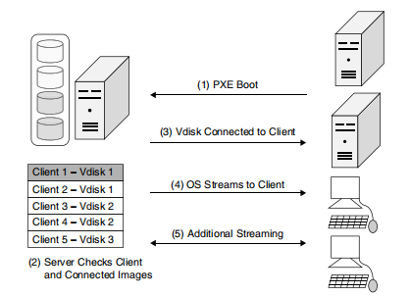
Fig. Operating System Virtualization and Streaming Process

Slide 29
OS Virtualization: Pros
Flexible provisioning: It is very simple and easy to connect different virtual disks to a system through OS virtualization. Starting another operating system or any other application can be done easily by the client.
Rapid software deployment: Adding a new server or workstation happens within few seconds. Using deployment tools to install and configure the system or doing it manually takes at least a few hours, with a few steps the client is allocated to a virtual disk and can be used in production.
Easy and efficient implanting updates and hotfixes of the operating system and applications: In OS virtualization, it is enough to add an update to the virtual disk image and not to all servers.
Easy rollback scenarios: Rollback to previous state is easy in OS virtualization.

Slide 30
OS Virtualization: Cons
No work off-line capability: OS virtualization products must be connected to the virtualization server for using the operating system virtually.
High-speed LAN recommended: A high-speed LAN is needed as the virtual disk is connected to the OS virtualization server through the network.
Limited numbers of operating systems are supported: Limited number of OS supports virtualization. Some Linux distributions do not support the OS virtualization technique.
Imaging disadvantages apply to this technique: Virtual disk is created using imagebased techniques. All disadvantages of imaging techniques are also applicable for the OS virtualization component.

Slide 31
OS Virtualization: Sample Scenarios
Citrix XenApp/terminal servers: Citrix XenApp/terminal server-based infrastructures OS virtualization is a good solution. After each reboot the terminal server is back in its default state and changes are applied to all servers by using the shared virtual disks.
VDI/DDI solutions: Virtual desktop infrastructure solutions are also becoming increasingly fashionable today. With the OS virtualization, the same virtual disk can be used by virtual machine and no expensive disk space is required on the SAN.
Back-up servers: Back-up servers are used only for few hours a day, and the hardware is idle most of the time. Therefore, the hardware can be used for other roles during business hours and it can also be assigned to the back-up server role.
Development/test environments: OS virtualization can easily provide the machines to run development and test tasks on virtual hardware by flexible provisioning.
Educational environments: Using OS virtualization, multiple virtual disks can be created and assigned with multiple OS environment. The user can select the required environment using the boot menu.
Secure environments: OS Virtualization can be used for secure environments, as no data is available on that machine.

Slide 32
Storage Virtualization:
Storage virtualization (SV) is a new concept under virtualization. Storage systems use virtualization concepts for better functionality and have more features within the storage system.
The other name for storage system are storage array, disk array or filer. Storage systems use special hardware and software, which provides fast and reliable storage for computing and processing data.
Storage systems are complex and specially designed to accommodate storage capacity with data protection.
Storage systems provide block and file accessed storage.
Examples for block accessed are Fibre Channel, iSCSI(small computer system interface), FICON(Fiber connection ); File accessed examples are NFS and CIFS(common internet file system).
There are two primary types of storage virtualizations:

Slide 33
1. Block virtualization separates the logical and physical storage. This gives greater flexibility for the administrators in managing storage for consumers.
2. To eradicate the dependencies between the facts and numbers accessed at the document level and the position where the documents are retained, file virtualization method is utilized. This method optimizes usage of storage and server consolidation.
Storage virtualization contributes high in traffic mirroring, and migrates LUNs from one disk array to another without downtime.
Virtualization is the pools multiple physical storage as a single storage device that can be managed from a central console.
The managing storage devices can be slow and timeconsuming.
Structure of storage virtualization will be in the form of what are created, where the virtualization is done and how it is implemented.

Slide 34
Mainly storage virtualization is structured in three ways:
1. Host-based: Traditional device handles physical drives.
2.Storage device-based: Pooling and managing metadata.
3. Network-based: Device which uses fibre channel.

Slide 35
Network Virtualization
The procedure of blending the accessible assets in a mesh by dividing up the accessible bandwidth into channels is called network virtualization
A virtual machine can be configured with one or more virtual Ethernet adapters.
Virtual switches which permit virtual machines on the same virtualization hardware host to communicate with everyone through the same protocols that would be used over physical switches, without the need for extra hardware.
Network management is a time-consuming process for a network administrator.
Network virtualization can improve productivity and efficiency by performing tasks automatically.
Network speed, reliability, flexibility, scalability and security can be optimized using network virtualization.
Two main scenarios focused by network virtualization are as follows:
1. A shared experimental facility, i.e.,running multiple experiments at the same time.
2. Long-term solution for the future Internet.

Slide 36
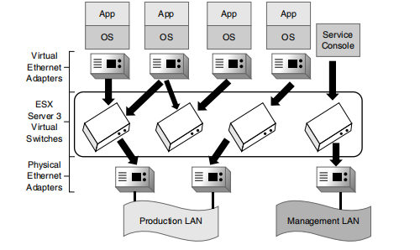
Fig. Network Virtualization
Virtualization is categorized as either internal or external based on the implementation given by vendors that support the technology.

Slide 37
External network virtualization: In this situation, to achieve the objective of improving the efficiency of a large corporate network or data centre by combining one or more local networks or subdivided into virtual networks.
Internal network virtualization: A single system is configured with containers using Xen/KVM domain and combined with hypervisor control programs, for example, VNIC (Virtual Network Interface Card) to create a ‘network in a box’.
Examples of internal network virtualization are Network Stack project, OpenSolaris network and Microsoft virtual server.

Slide 38
VIRTUALIZATION ARCHITECTURE AND SOFTWARE
MultiNet Protocol Driver (MPD) (shown in fig.) is used to implement virtualization of wireless adapter and placed as an intermediate layer between MAC and IP.
MPD can be used to share a wireless network adaptor and its MAC.
MPD sits in between IP layer and physical layer (MAC).
When an application wants to use more than one network than using TCP/IP, the path is sent to MPD, which is responsible for switching and allocating the network and appropriate MAC address.
MPD exposes the wireless LAN media adapter as always active.
Switching and buffering of packets across networks is done by MPD.
illustrates the virtualization of a WLAN card, where a user needs to connect to three networks (wireless).
The MPD represents three virtual adapters, and everything appears
active to IP even though only Network 2 is active at the moment as depicted in the figure.

Slide 39
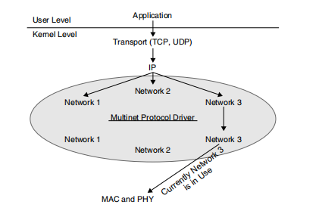
Fig. Modified Network Stack

Slide 40
Freebies for virtualization tools are available from Microsoft and VMware and they are from the open source community. Some examples are listed as follows:
OpenVZ: This is a Linux-based software where the administrator can create protected virtual environments. Every virtual server can be rebooted separately. SWsoft supported this project and markets this in the name of ‘Virtuozzo’.
Q: It is a FOSS kind of software for running other programmers on Macintosh. It enables the users to exchange fi les between host operating system and the guest OS. Q is based on the QEMU open source CPU emulator.
QEMU: QEMU can run operating systems and programs developed for one machine on a different machine. Only restriction for QEMU is host and the guest machine must use x86-compatible processors.
VMware Server, Player and Converter: VMware Server is VMware’s starter kit for Windows and Linux server virtualization. It can host Windows, Linux, NetWare and Solaris as guest operating systems.

Slide 41
VIRTUAL CLUSTERING
Cluster is defined as “a type of parallel or distributed system that consists of a collection of interconnected computers and is used as a single, unified computing resource”.
A cluster refers to a collection of computers bounded together to form a common resource pool. A task or job can be executed on all computers or a particular computer in the cluster.
Benefits of Clustering:
Scientific applications: Applications running on supercomputers can be migrated to Linux.
cluster (which is more cost effective).
Large ISPs and E-commerce enterprise with large database: Internet service providers or e-commerce web site that requires high availability and load balancing and scalability.

Slide 42
Graphics rendering and animation: Film industry is benefited because of clustering, in particular for rendering quality graphics and animation scenes. Examples include Titanic, True Lies and Interview with the Vampire.
Fail-over clusters: Using clusters, network services are increased in terms of availability and serviceability and when a server fails, its services are migrated to another system. For example, failover servers are database servers, mail servers and fi le servers.
High availability load balancing clusters: Application can run on all computers and can host multiple applications. Individual computers are hidden to the outside world as they interact only with the clusters. This kind of clustering produces best results with stateless application and when executed concurrently

Slide 43
VIRTUALIZATION APPLICATION
Application virtualization is a term, which describes a new software technology has a technical edge over improving portability, compatibility and manageability of various applications by
encapsulating them from its base OS, on which they are executed.
A virtualized application is not installed as in case of any other software/application, but it is executable as it is installed.
The virtualization refers to ‘encapsulated application’, whereas in
hardware virtualization is referred as ‘abstracted hardware’.
Technology Types Under Application Virtualization:
Application streaming
Desktop virtualization/virtual desktop infrastructure (VDI)
Benefits of Application Virtualization:
Non-native applications can be executed (i.e., windows applications in Linux)
Protection for the operating system
Lesser resources are used

Slide 44
Able to run applications with bugs (i.e., accessing read-only system owned location for storing user data)
Incompatible applications can be executed with lesser regression testing
Migration of various operating systems is simplifi ed
Faster application deployment and on-demand application streaming
Security is improved as applications are isolated from operating systems
Enterprises can easily track license usage.
Tracking license usage is done easily for applications
No need to install the applications, as it can be imported from portable media to client computers.

Slide 45
Limits for Application Virtualization
All softwares cannot be virtualized. Examples include device driver and 16-bit applications.
Anti-virus packages require direct OS integration, these packages cannot be virtualized.
For legacy applications, file and registry level compatibility issues can be resolved using virtualization in newer operating systems.
For example, Windows Vista applications will not run where they don’t manage the heap correctly. For this reason, application compatibility fixes are needed.

Slide 46
PITFALLS OF VIRTUALIZATION:
Virtualization Benefits:
Server virtualization will serve the following purposes:
Improve the server’s utilization: When non-virtualization, servers utilization is about 25%. After deploying virtualization utilization increases to 70% and goes close to 90%.
Reduce the number of physical servers: It is typical to see consolidation of servers be in the ratio of 5:1 up to 10:1 range.
Contribute to corporate ‘green’ initiatives: Number of servers can be reduced through server virtualization. It will not only require less physical data centre floor space but also use a lesser power and need fewer cooling machines for the same workloads.
Give a fast return on investment (ROI): Business leaders demand one year of less time for ROI.
According to survey, a new technology should give ROI immediately (56%) and in a span time of one year (44%). It shows its speed in the field. Another 44% indicated an ROI ranging from one month to one year, a necessary condition for technology deployments today.

Slide 47
Best Practices in Setting Virtualization
Virtual servers are deployed in more businesses to save money on equipment and time for system maintenance.
Because of reduced overhead, the management can free up resources, which in turn can be applied towards innovation and other projects which will benefit the organization.
However, virtualization does have its drawback. Creation of new virtual servers can easily lead to uncontrollable server position. Keeping a lot of applications on one node can leave them contending for resources.
And managing your virtual resources among your physical machines can get complicated, especially for IT people managing only one application per physical server.

Slide 48
Following are few tips to help you to tackle some common challenges of virtualization.
Avoid Monopoly
Proactively Engage Stakeholders.
Balance Resource Needs: too many applications requesting for the same resources may leave those applications contending for inadequate RAM, processor capacity, disk I/O or network bandwidth.
Do not Overload Physical Servers.

Slide 49
Pitfalls of Virtualization: Adoption and Strategies
Introduction of virtualization has brought additional complexity into compliance and security efforts. The understanding and management is the key for achieving security and realizing the benefits of virtualization. Some pitfalls of virtualization adoption and strategies are given as follows:
Religious battles:Choosing platforms based on requirements and standards that can be created.
Procurement and business changes: As a first step, adopt and train the business people only by using resources such as memory, CPU, network and storage. Do not use by server. Then virtualize it.
Offer the business people by saying, ‘I can get you a physical server and storage for few thousands of rupees with a 3 or more year lease or I can get you virtual assets that we can bill month by month based on utilization and scale up or down depending on when you need to scale up or down’.

Slide 50
Myopic(short) virtualization strategy: Virtualization begins in server consolidation. Server, desktop, application, presentation and management are the five facets(aspect) of virtualization.
Physical cost recovery models: Practice real numbers and resource-based cost recovery. Practice a base building block as a cost unit and drive from that point.
Physical asset-based security: Virtualization unlocks some new security challenges. At the same time, it also provides solution to some challenges.
Over-virtualization: Virtualizing everything is wrong. It is not everything must be virtualized.
Virtualization is not a shiny gunshot. Virtualization is attached with a great ecosystem, appropriate operational processes and organization itself.

Slide 51
Pitfalls in Server Virtualization
Everyone speaking about virtualization and server consolidation nowadays and many companies are taking action, with large enterprises in the top.
Server consolidation over virtualization is a recognized way to save
money in numerous ways such as a smaller amount of hardware, lesser
power consumption, less floor space, etc
server virtualization to obtain significant economic and performance
benefits, there are data centre virtualization, application virtualization and
desktop virtualization.
No doubt, virtualization is the future of computing, since it decouples computing operating systems and applications from the hardware, offering massive flexibility and agility to an enterprise’s computing system.

Slide 52
Poor preparation: Any virtualization project is almost the first step towards a completely virtualized network that is going to be much different than the tried and tested hardwarecentric system. Adding virtual OS to boost computing power may create problems.
Insufficient server capacity: Virtualization does not increase the computing resources, but only the usage. Substantial processing power, input/output capacity, memory and disk capacity needed when multiple operating systems are virtualized.
Mismatched servers: When multiple servers are virtualized which uses different chip technologies (Intel and AMD), there will be various problems while migrating VMs between them. It is recommended to standardize servers on a single chip technology.
Slow network communications: One of the main objectives of virtualization and its main advantage is an enormous bound in computing capacity for a specifi- ed amount of hardware.
However, latency and network bandwidth can give away much of the proposed gain. Upgradation of network’s communications capabilities are required.

Slide 53
Slow mechanical disks: Present disk technology cannot retain with the read/write demands of multiple servers in high-demand peak hours, you will face some latency. Storage caching is solution to this problem, whereby repeatedly accessed data is served from faster memory
instead of disks. Another solution is solid state disks, which ensures
read/write speeds up to 30 times quicker than spinning-disk technology.
Uneven workload distribution: Finetuning the distribution of processing requirements across all physical servers is needed to maximize usage of data centre computing power. It means, there is need to monitor usage of application to detect daily, weekly or monthly highest usage and control response times and so on.This will permit you to assign applications accordingly.
Security risks:Virtualization does not improve network security by itself. Firewalls, antivirus needs to be installed and keep them repaired and updated. And also virtualization applications are updated and patched. Finally, design of virtualized infrastructure is required to separate signifi cant data as much as possible.

Slide 54
VIRTUALIZATION IN GRID
Grid Computing:Grid computing is a computing infrastructure that combines computer resources spread over different geographical locations to achieve a common goal.
The main focal point in grid computing lies in secure resource sharing in accessing computers, software and data in a dynamic atmosphere.
Sharing of those resources has to be fine-tuned and handled in a highly controlled manner
The following three points to
describe a grid more in detail:
1. Nontrivial qualities of service delivery
2. Habit of using standards in all places
3. Resources coordination

Slide 55
Grid Computing and Virtualization:
Virtualization is not a solution for enterprises to manage their resources although it provides richer capabilities in managing and moving the OS in different hardwares. It helps to run multiple workloads in a single machine with clear distinction between them.
Virtualization can do suspending, resuming and migrating images in run-time.
Like grid, virtualization is also a trend. Instead of having more hardwares to meet peak demands, organizations can use virtualization approaches to get better utilization out of the existing hardwares which are not fully utilized.
Using Virtualization in Grid Computing:
Virtualization integration and grid computing can be encouraged at various levels.

Slide 56
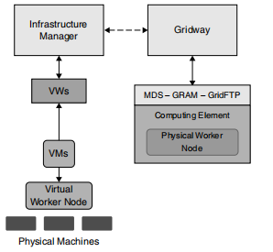
Fig. Dynamic Provisioning of Computational Services in Grid

Slide 57
VIRTUALIZATION IN CLOUD
Virtualization is a tool for system administrators, which has many technical uses than a cloud.
Virtualization allows IT organizations to perform multiple operations using a single physical hardware. Multiple OS instances running on single device is cost-effective than multiple servers for each task.
Cloud computing is accessed through the WWW and takes advantage of virtualization.
Cloud computing can also be used without virtualization.
Virtualization and cloud computing can go hand in hand. Virtualizing everything started a year ago when processing power, software and servers are virtualized.

Slide 58
Now-a-days virtualization means cloud computing.
Cloud computing refers to IT organizations using remote servers for storing data and accessing information from anywhere.
This is done in three ways—public cloud, private cloud and hybrid cloud.
Virtualization has various forms, for example, one can virtualize a desktop which means, that the desktop is stored virtually in the clouds and that can be accessed from anywhere.
Virtualization got more familiar in 2009 and 2010 because of the recession. IT organizations used virtualization to save infrastructure cost.
Cloud was implemented as outsource model first and then gradually was implemented within the enterprise firewall as an architecture.

Slide 59
On the other hand, virtualization was started within the limitations of enterprise firewall and then was operated in hosted environments.
Even if there are differences and similarities, many people in the industry use them interchangeably.

Slide 60
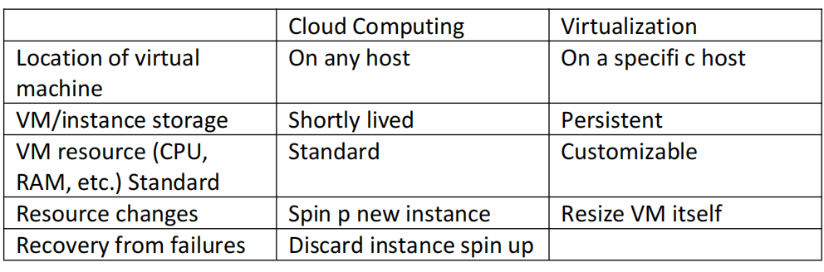
Smilarities between Cloud Computing and Virtualization
Attempt to recover failed
VM

Slide 61
Cloud computing is a technology. Private cloud does not adopt virtualization.
It uses technologies that are highly flexible and provide multiple services.
Virtualization and cloud computing are associated closely.
VMware, Microsoft and Citrix Systems are the major hypervisor vendors trying to adopt it in the cloud.
They modified their products with tools (i.e. hypervisor), promoting the usage of private cloud computing

Slide 62
VIRTUALIZATION AND CLOUD SECURITY
Security in the cloud is achieved due to virtualization. Since virtualization combines all physical components as a single unit, the complexity of monitoring these components is made easier.
Trust zones are created and personalized by the IT administrator.
These zones watch workloads in terms of information, application and endpoints.
Zones created are watched through the cloud by means of infrastructure virtualization.
Automated SLAs can then evaluate risk and instigate remediation when security troubles arise instantaneously.

Slide 63
VIRTUAL INFRASTRUCTURES
In the present scenario, the Internet provides services such as research, mining, e-mail and maps.
In the near future, it will converge communication and computation as a single service.
Hence the Internet cannot be considered as a huge shared and unreliable communication enabling data exchanges between users. Instead, it will become a pool of interconnected resources that can be shared.
Virtualization abstracts services and physical resources.
It simplifies the job of managing the resources and offers a great flexibility in resource usage.

Slide 64
The vitrual machine
Provides an environment where non-trusted applications can be run.
Adopts isolation techniques
Allows dynamic deployment of application (portability)
Applied optimization in OS
Manages as a single service.

Slide 65
CPU VIRTUALIZATION
For virtualizing a CPU, the following points are to adhered:
Privileged instructions runs only in privileged mode.
Control sensitive instructions that tend to change memory mappings, communicating with other devices.
Behavior-sensitive instructions that tend to change resource configuration.
By adopting CPU virtualization,two separate CPUs resemble a single CPU, i.e., two systems running in a single system.
By adopting this concept, user can run two OS in a single system.
The main objective of CPU virtualization is to make a CPU function similar to that of two separate CPUs.

Slide 66
CPU virtualization allows the users to run different operating systems simultaneously.
For example, Apple Mac can be virtualized to run Windows as well.
CPU virtualization is not multitasking or multi-threading.
Multitasking is concept of running multiple applications at a time.
Multi-threading is where more than one CPUs can run applications in a way that carries out two actions at the same time.

Slide 67
NETWORK AND STORAGE VIRTUALIZATION
Network virtualization facilitates running of multiple networks, multiple consumers over a shared substrate.
Network virtualization is a method which combines the available resources by splitting up the bandwidth into channels and assigned to device or user in real time.
Each channel is independently secured. Every consumer will have shared access to all the resources on the network.
By adopting network virtualization, managing the network will be an easier job and less time-consuming for network administrators.
Productivity and efficiency are improved using network virtualization. Files, images, programs and folders can be managed centrally.
Storage media such as hard drives and tape drives can be added, removed and shared easily.
Network virtualization is categorized as: external and internal.

Slide 68
External format: In this format, multiple local networks are combined or subdivided into virtual networks to improve the effi- ciency. VLAN and network switch are the components of this format.
Internal format: In this format, a single system is confi gured with containers or hypervisors, such as the Xen/KVM domain to control VNIC.
By adopting this format, overall efficiency of a single system is improved since applications are isolated.
Components of a virtual network consists of:
Network hardware components such as network switch, adapters (NIC)
Network elements e.g., firewalls
VLANs and VMs
Network storage devices
Network mobile elements e.g., tablets, mobiles
Network media e.g., ethernet cards and fibre channels

Slide 69
Storage Virtualization
Storage virtualization is a concept where storage devices are virtualized.
better functionality, proper maintenance of storage devices and efficient backup procedures can be achieved.
A storage system is also called as storage array or disk array.
Storage systems are complex and are controlled by special systems providing high data protection for the data stored in it.
There are two types of storage virtualization: block virtualization and fi le virtualization.
1.

Slide 70
1.Block virtualization separates the logical storage from physical storage. Accessing can be done without the knowledge of where the physical storage is located and its nature (heterogeneous).
Storage virtualization allows storage administrators greater flexibility in managing the storage devices and the users.
2.File virtualization takes care of NAS by eliminating the dependencies between file level and the location. Due to file virtualization, optimization of storage and migrations of storage devices can be done easily.
Benefits of Storage Virtualization:
on-disruptive data migration: Ability to migrate data without disturbing concurrent I/O access.
Improved utilization: Utilization can be increased by pooling and migration. When all storage media are pooled, the administrator can easily maintain the devices and also assign disks for the users

Slide 71
Risks and Complexities
Risks in block virtualization are:
Backing out a failed implementation
Interoperability and vendor support
Complexity affects several areas, they are:
Management of environment
Infrastructure design
The software or device itself
Performance and scalability

Slide 72
Using Virtualization to Achieve Green Data Centres
Green IT and virtualization are the two important topics that will impact the change in solution
providers and value-added resellers (VARs).
The hardware resellers, probably they will lose hardware order because of server virtualization.
With server virtualization, instead of buying more servers, 8–15 virtual systems can be deployed on one physical server.
Overall impact, because of virtualization is to reduce the hardware and power consumption.
Desktop virtualization is also becoming popular.
Thin clients will replace the normal desktops.

Slide 73
The biggest problem involving green data centres are because of humans, changing of their minds, their behaviour towards the new model in accepting, trusting and working with it.
There are number of cost benefits in using virtualization and adopting to green data centres.
They are:
Power consumption to run the system and to cool it
Space for systems is reduced
Administrative work—managing the systems will be easier

Slide 74
END

